Slide 1
ENGR 1182 – Fundamentals of Engineering Graphics Preparation 07 – Wheel

Slide 2
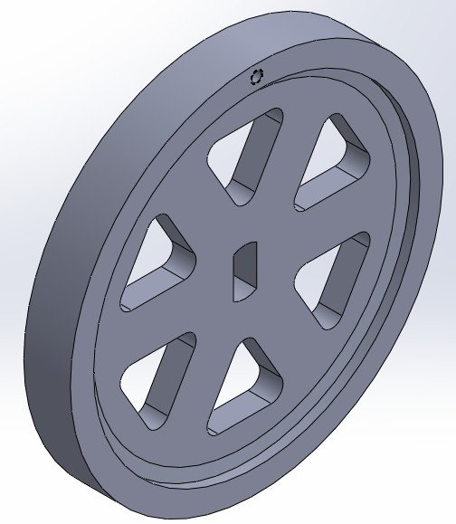
Part to be created: Wheel
Purpose: Create a complex part using revolve and patterning.
Description: Follow the SolidWorks tutorial to create the part to the right.
Deliverables: A completed wheel part submitted using standard submission practices for parts.

Slide 3
SolidWorks Skills Developed:
Revolved sketches
Repeated Circular patterned features
Extruded Cuts
Tapped Holes
Hole Wizard
3D Sketches

Slide 4
Introduction
The wheel part will be created by first sketching the profile and revolving around an axis. This revolve will create the round disk that is the base for the wheel. Then triangular cuts will be created using the extruded cut and the circular pattern features. The hole for the shaft will then be another extruded cut, and the hole that will attach to the handle will be a tapped hole created using the Hole Wizard.

Slide 5
Disclaimer
This tutorial was designed using a desktop version of SolidWorks. It’s highly recommended that you attempt this tutorial on a desktop computer in Hitchcock Hall. The First Year Computer Lab, located in HI 316, is an excellent location to complete this tutorial. If you wish to use SolidWorks on a personal laptop, please keep in mind that there may be small discrepancies between what you will see on your laptop and what you see on the slides. Lastly, if you’re going to use your laptop, please, please, please use a mouse and not your laptop’s trackpad.

Slide 6
Additional Note Before You Start
Some of the steps covered in this assembly must be followed closely to ensure that the part is created correctly. Go slow, follow each step carefully, and ask questions if you get stuck.

Slide 7
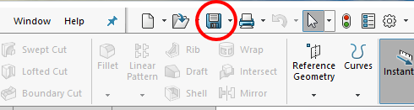
Procedure
Open SOLIDWORKS and create a new part.
Make sure the part is in English units [IPS (inch, pound, second)].
Ensure that the Overall Drafting Standard is set to ANSI.
Let’s preemptively save the part as Engine_Wheel by clicking on the Save icon in the toolbar.

Slide 8
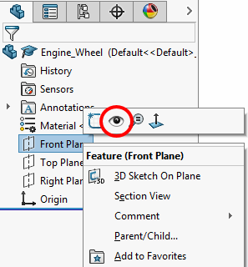

Procedure
5.In the Feature Manager Design Tree panel to the left of the workspace, right click on the Front Plane.
6. Then, click on the Show icon, which looks like an eye.
7. Then, right click on the Front Plane again and click on the Normal To icon.

Slide 9
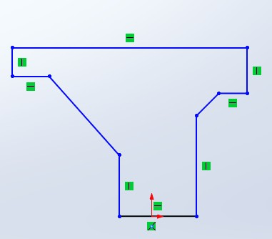
Procedure
8. Create a sketch on the Front Plane.
9. Create the sketch shown in the image to the right. Do not worry about overall dimensions, just the relative positions of the vertices.

Slide 10
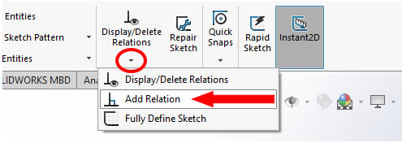
Procedure
10. Now, relations need to be added to ensure that the part is constrained appropriately using the Add Relation tool from Display/Delete Relations.

Slide 11
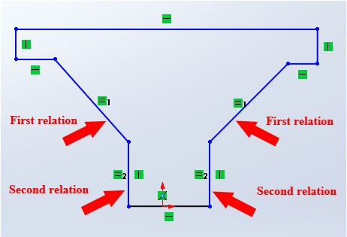
Procedure
11. Click on the two angled lines and apply the Equal relation. Accept the relations with the green checkmark. Depending on your sketch proportions, the upper right corner may “fold” which will be corrected in step 12, so do not add extra relations yet.
12. Repeat the process for the two vertical lines below the angled lines. The sketch should look approximately like the image to the right.

Slide 12
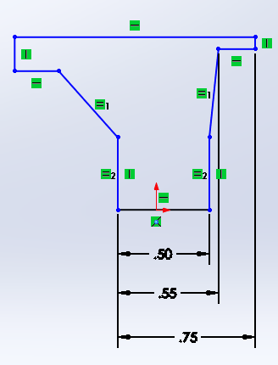
Procedure
13. Use the Smart Dimension tool to apply the dimensions shown in the image to the right.

Slide 13
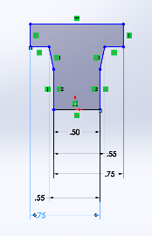
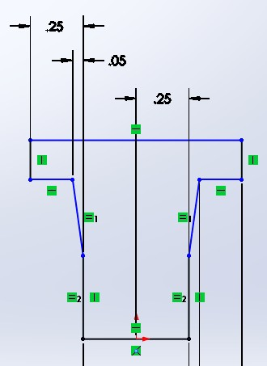
Procedure
14. Continue to use the Smart Dimension tool to apply the same dimensions to the other side of the part. Also, apply the 0.25 inches dimension to ensure the part is centered about the origin as well as the other dimensions shown on the right.
If your part does not look like the images to the right, you may have to dimension in a different order.
1
2

Slide 14
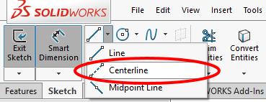
Procedure
15. To apply the height dimensions, you are going to need to create a centerline about which this feature will be revolved.
16. To do so, click on the dropdown arrow next to the Line tool and select Centerline.

Slide 15
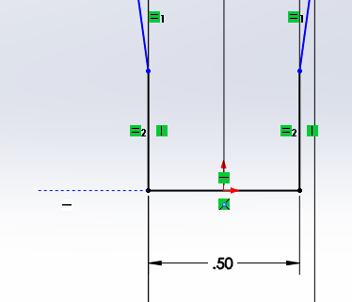
Procedure
17. Then, take your cursor to the left of the origin. You should see a series of blue dots that ensures you are aligned with the origin. Then, click once.

Slide 16
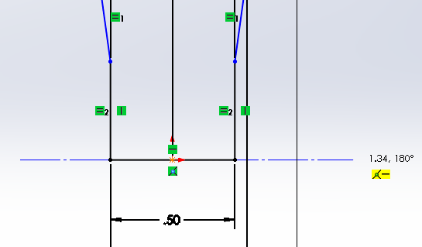
Procedure
18. Move your cursor over to the right of the origin and click again. Make sure you see the Horizontal symbol appear in the yellow box before.
19. Then, hit Esc to accept the centerline.

Slide 17
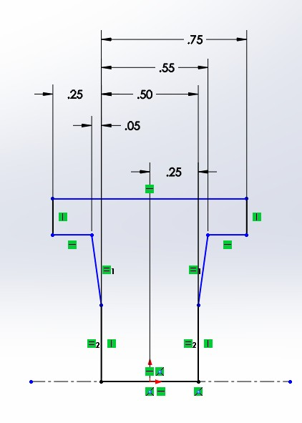
Procedure
20. For ease of visibility, click and drag all the previously applied dimensions above the sketch, as shown to the right.

Slide 18
Procedure
21. Now, to apply the height dimensions, linear diameter dimensions will be used because the part is going to be revolved. This means that you can set the dimension based on the final diameter that you want the part to be instead of having to determine radial dimensions.

Slide 19
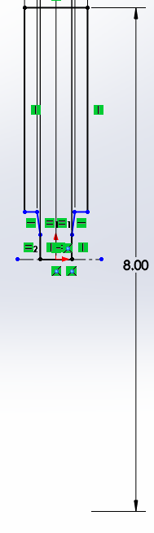
Procedure
22. To start, select the Smart Dimension tool.
23. First, click on the centerline you previously drew.
24. Next, click on the top horizontal line.
25. Follow these directions exactly: Drag the cursor off the part to the right and below the centerline you drew in previous steps. Then, click to place the dimension. Set this dimension to 8.00 inches, as shown in the image to the right.

Slide 20
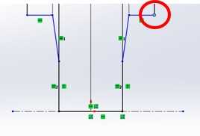
Procedure
26. Then, while still in Smart Dimension mode, click on the vertex circled in the image to the right. Since you have previously put a linear dimension on the part, SOLIDWORKS should automatically assume it is a linear dimension whether you are above or below the centerline.

Slide 21
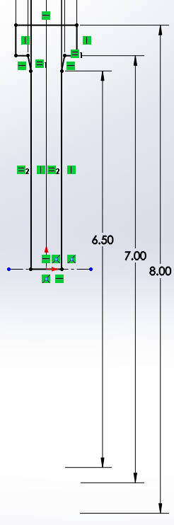
Procedure
27. Repeat this process and to apply the dimensions shown in the image to the right.
28. Exit the sketch.
If you are having trouble dimensioning, you may have accidentally added an extra relation. Double check that you only have two equal relations (you can do this by clicking on Display Relations and clicking on the lines you want to view).

Slide 22
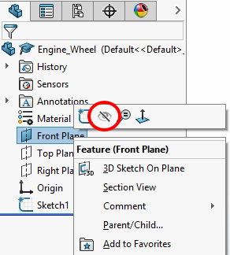
Procedure
29. To remove visibility of the Front plane, right click on Front Plane in the Feature Manager Design Tree panel to the left of the workspace.
30. Then, click on the Hide icon, which is like the icon used to show the plane but appears instead as an eye with a slash through it.

Slide 23
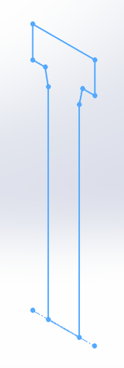
Your drawing should look like the image to the right.

Slide 24
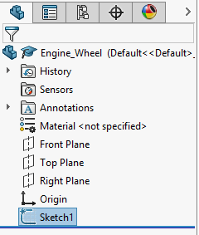
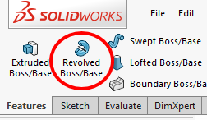
Procedure
31. Now, the next steps involve revolving the sketch you just made about the centerline, which in this case is the x-axis.
32. To do so, left click on Sketch1 in the Feature Manager Design Tree panel to the left of the workspace.
33. Then, click on the Features tab and select the Revolved Boss/Base icon.

Slide 25
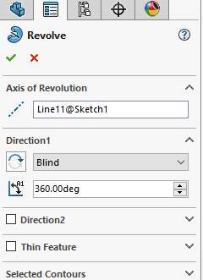
Procedure
34. SOLIDWORKS should automatically select the centerline you drew as the axis of revolution. If it did not, click on the centerline and ensure that it appears in the Axis of Revolution window.
35. In the Revolve panel to the left of the workspace, ensure that the settings under Direction1 match those in the image to the right.
36. Click on the green checkmark to accept the revolution.

Slide 26
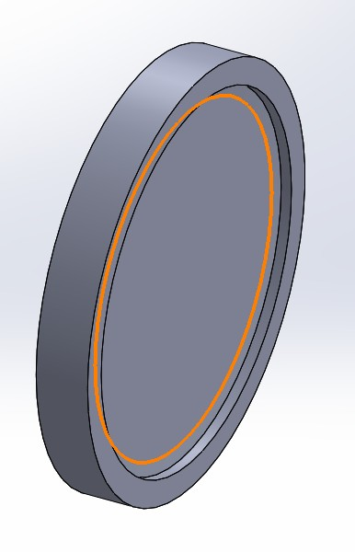
Procedure
37. The part should now look like the image to the right.
38. Next, you will add some features to the wheel.
39. Using the Sketch tool, create a sketch on the surface outlined in orange in the image to the right.

Slide 27
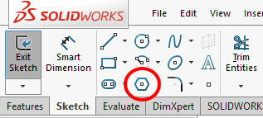
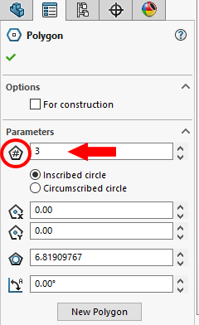
Procedure
40. If not done automatically, use the Normal To icon in the View Orientation menu to look directly at the sketch.
41. Select the Polygon tool in the Sketch tab.
42. In the Polygon panel that appears to the left of the workspace, change the Number of Sides (Parameters) to 3.

Slide 28
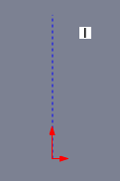
Procedure
43. Place the cursor above the origin. Once you see the blue dots, click once to start drawing of the polygon.

Slide 29
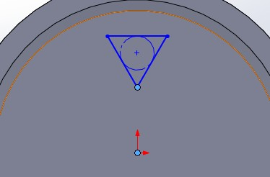
Procedure
44. Drag the cursor around to create a profile of the triangle similar to that shown in the image to the right.
45. Click on the green checkmark to accept the polygon.
46. Apply a horizontal relation to the top segment of the triangle

Slide 30
Procedure
47. You also need to apply a vertical relation between the bottom point of the polygon and the origin. While in the Add Relation mode, click on the two points highlighted in blue in the image shown on the right. Then click the vertical relation icon in the Add Relation Panel. Click the green checkmark to accept the relation.
48. Using the Smart Dimension tool, dimension the side of the polygon and set it to 1.35 inches.

Slide 31
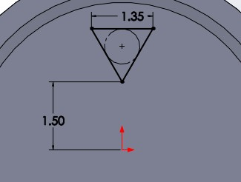
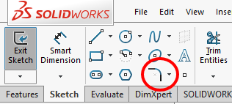
Procedure
49. When you apply this dimension, the triangle might move. You need to also dimension the relative position in the y-direction of the triangle. Apply the dimension shown in the image to the right.
50. At the three vertices of the triangle, apply a fillet of radius 0.25 inches. To do so, select the Sketch Fillet tool in the Sketch tab.

Slide 32
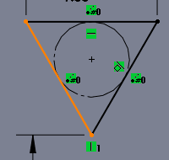
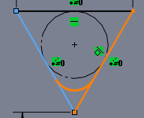
Procedure
51. To select a vertex, select the lines on each side of the vertex. For example, click on the first line shown in orange in the first image below. Then, click on the line shown in orange in the second image below.

Slide 33
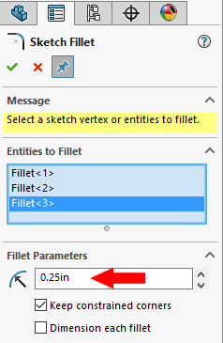
Procedure
52. Alternatively, you can select a vertex by clicking on the vertex itself. Select all 3 vertices using either method.
53. Change the fillet radius to 0.25 inches in the Sketch Fillet panel to the left of the workspace.
54. Click on the green checkmark to accept the fillet. Then click the green checkmark again to exit the Sketch Fillet panel.

Slide 34
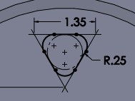
Procedure
55. The final sketch should look like the image to the right. It may also show many relations.
56. Exit the sketch.

Slide 35
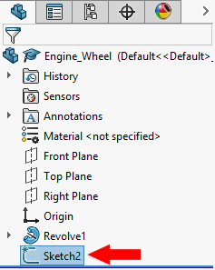
Procedure
57. Click on Sketch2 in the Feature Manager Design Tree panel to the left of the workspace.

Slide 36
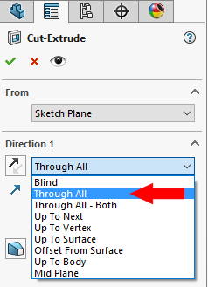
Procedure
58. Then, click on the Extruded Cut icon in the Features tab. The triangular feature you just sketched should be automatically selected. If not, select it.
59. Change the End Condition to Through All.
60. Click on the green checkmark to accept the cut.

Slide 37
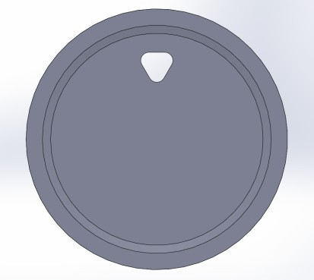
Procedure
61. The wheel should now look like the image below.

Slide 38
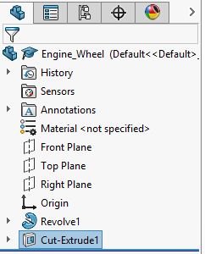
Procedure
62. Now, you need to cut other holes into the wheel using the Circular Pattern tool. Before you begin, put the part in Isometric view.
63. Then, click on Cut-Extrude1 in the Feature Manager Design Tree panel to the left of the workspace.

Slide 39
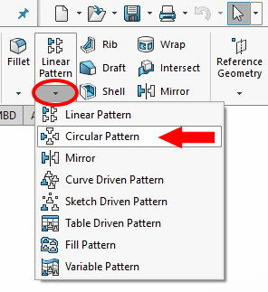
Procedure
64. On the Features tab, click on the arrow below the Linear Pattern icon.
65. Then, click on Circular Pattern.
66. The first thing you need to select is the feature that you wish to create the circular pattern from. This is already selected since you clicked on the extrusion prior to selecting the Circular Pattern tool. Ensure that Cut- Extrude1 appears in the Features to Pattern window.

Slide 40
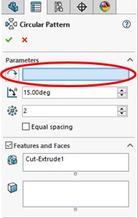
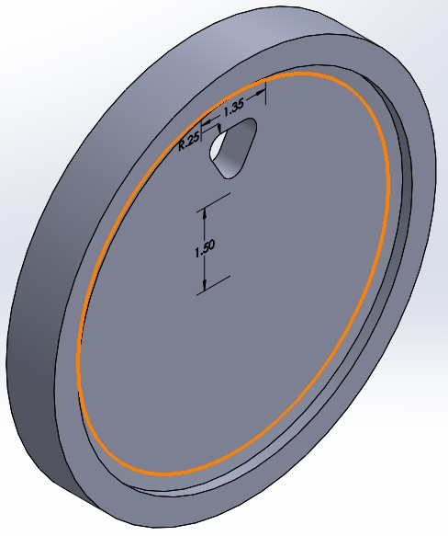
Procedure
67. Next, you will select the axis of rotation. For this, you can also select a circular feature that is circular about the same axis as the desired pattern. For this tutorial, first click on the Pattern Axis window, circled in red, and then click on the edge of the wheel, shown in orange in the image to the right.

Slide 41
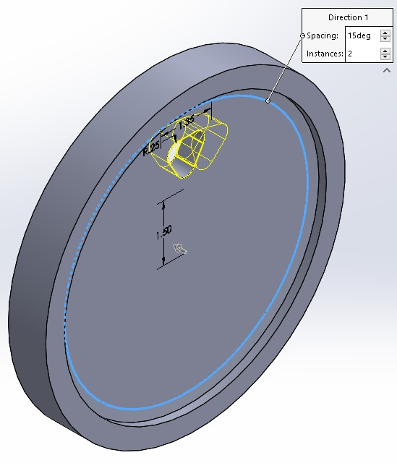
Procedure
68. Once you click on the edge, it will become blue. You will also see an additional outline of the triangular cut in yellow. This is a preview of the pattern.

Slide 42
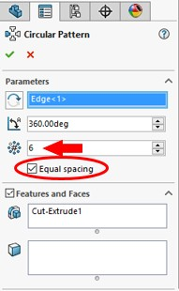
Procedure
69. Change the Number of Features to 6.
70. Check the Equal spacing box. This will update the Total Angle to 360 degrees.
71. The Circular Pattern panel to the left of the workspace should now look like the image to the right.

Slide 43
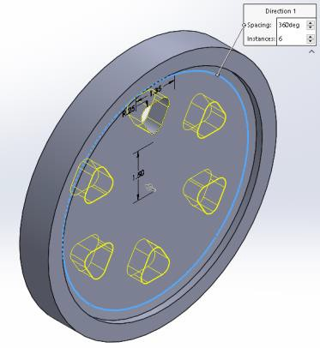
Procedure
72. The wheel should now show an updated preview of the new extrusions, as in the image to the right. If the Sketch does not indicate FULLY DEFINED, use the mouse to grab the Center Pattern Center Point and move it slightly off the center of the wheel and then move it back to the center of the wheel to achieve FULLY DEFINED.
73. Click on the green checkmark to accept the circular pattern.

Slide 44
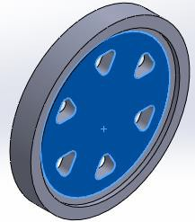
Procedure
74. Once the circular pattern is completed, select the inner face of the disk highlighted in blue in the image shown and start a new sketch.

Slide 45
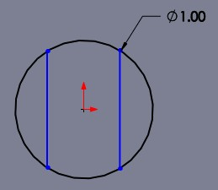
Procedure
75. You need to create a hole for a shaft to go through the wheel. Create the sketch of a circle centered at the origin with a diameter of 1.00 inch.
76. Add two vertical lines extending across the circle on each side of the origin.

Slide 46
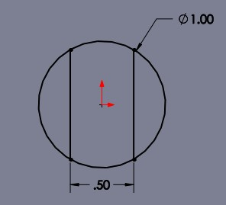
Procedure
77. Add the Equal To relation to the two lines you just drew.
78. Add a dimension to set the two lines to be separated by .5 inches.
79. The sketch should now look like the image to the right.

Slide 47
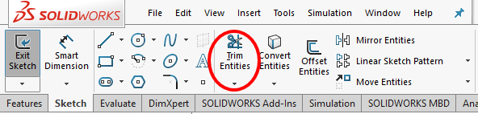
Procedure
80. Now, the left and right sides of the circle need to be erased. Click on the Trim Entities icon in the Sketch tab.

Slide 48
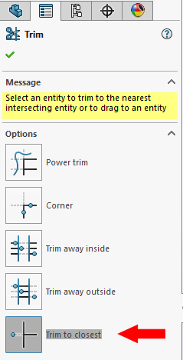
Procedure
81. Ensure that Trim to Closest is selected in the Trim panel.

Slide 49
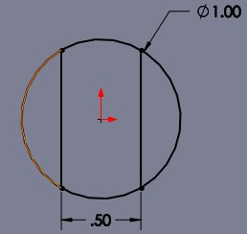
Procedure
82. Click on the left side of the circle highlighted in orange in the image shown. The section of the line should disappear.
83. Repeat this step on the right side of the circle.

Slide 50
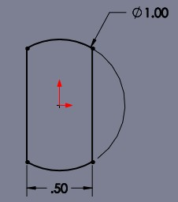
Procedure
84. The sketch should now look like the image to the right. Click the green checkmark to exit the Trim panel.
85. Exit the sketch.

Slide 51
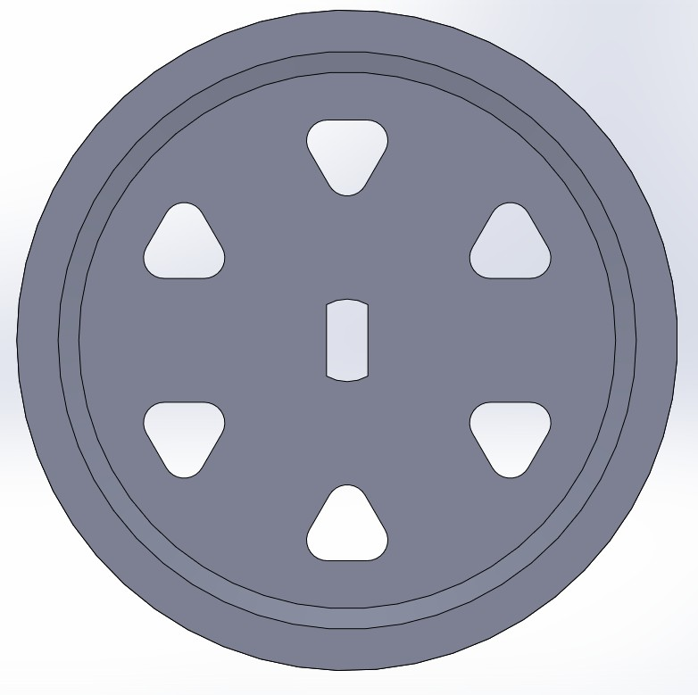
Procedure
86. On the Features tab, select Extruded Cut. Select the new sketch you just made and set the End Condition to Through All. Finish the cut with the green check mark.
87. The wheel should now look like the image to the right.

Slide 52


Procedure
88. Ooops! The triangular cuts you made earlier are too small. To fix this problem, click on the drop-down arrow next to Cut-Extrude1 in the Feature Manager Design Tree panel to the left of the workspace.
89. Then, right-click on Sketch2 and click on the Edit Sketch icon.

Slide 53

Procedure
90. Change the dimensions to match those shown in the image below.

Slide 54

Procedure
91. Exit the sketch. You will see that all of the circular pattern features will update as well.
92. The wheel should now look like the image to the right.

Slide 55

Procedure
93. To finish the wheel, the last step is to create a tapped hole for the handle. This will be done using the Hole Wizard. Start by selecting the Hole Wizard in the Features tab.

Slide 56

Procedure
94. In the Type tab, select Straight Tap, ANSI Inch under Hole Type, and ¼-20 under Hole Specifications, as shown in the image to the right.
95. Under End Condition, leave it set to Blind but change the depth to 0.5 inches, as shown in the image to the right.
96. Then, click on the Positions tab. Do not click the green checkmark.

Slide 57


Procedure
97. Now you need to select the face on which you want to put the hole. Select the outer most surface, shown outlined in orange in the image to the right.
98. You will now see an outline of the hole in yellow. Click on an arbitrary location on that surface, shown in the image to the right.

Slide 58

Procedure
99. Use the Smart Dimension to dimension from the hole to the origin, or the center of the wheel. Set that dimension to 3.75 inches.
100. Apply a dimension to align the hole in relation to the origin, shown in the image to the right. Change the 2.09 dimension shown in the image to 0 inches.
101. Accept the feature using the green checkmark. Click the green checkmark again to exit the Hole Position panel.

Slide 59
Procedure
102. The finished wheel should look like the figure to the right. Be sure to save the part.

Slide 60
Deliverables:
A complete wheel part submitted using standard submission practices for parts.

